Slide 1
MySQL in Python
MySQL
Dr.M.Jothish Kumar
Assistant Professor Senior,
School of Information Technology and Engineering,
Vellore Institute of Technology, Vellore.

Slide 2
Introduction to MySQL Python connector
To access the MySQL database from Python, you need a database driver.
MySQL Connector/Python is a standardized database driver provided by MySQL.
MySQL Connector/Python is designed specifically to MySQL.
MySQL Connector/Python allows you to compress the data stream between Python and MySQL database server using protocol compression.
It supports connections using TCP/IP socket and secure TCP/IP connection using SSL.
MySQL Connector/Python is an API implemented using pure Python
MySQL Connector/Python supports almost all features provided by MySQL version 5.7.

Slide 3
Installation
The MySQL Python Connector is available on pypi.org, therefore, you can install it using the pip command.
The pip command allows you to install MySQL Python connector on any Operating system including Windows, macOS, Linux, and Unix
pip install mysql-connector-python
Verifying MySQL Connector/Python installation
Open Python command line
Type the following code
>>> import mysql.connector
mysql.connector.connect(host='localhost',database='mysql',user='root',password='your pass')
Output:
mysql.connector.connection.MySQLConnection object at 0x0187AE50>

Slide 4
Connect to a MySQL Database in Python
MySQL is a server-based database management system. One server might contain multiple databases.
To interact with a database, you must first establish a connection with the server.
The general workflow of a Python program that interacts with a MySQL-based database is as follows:
MySQL is a relational database management system (RDBMS) that adopts a client-server model.
All this means is that a computer (the “client”) that wants to access data must connect to the RDBMS server to do so.

Slide 5
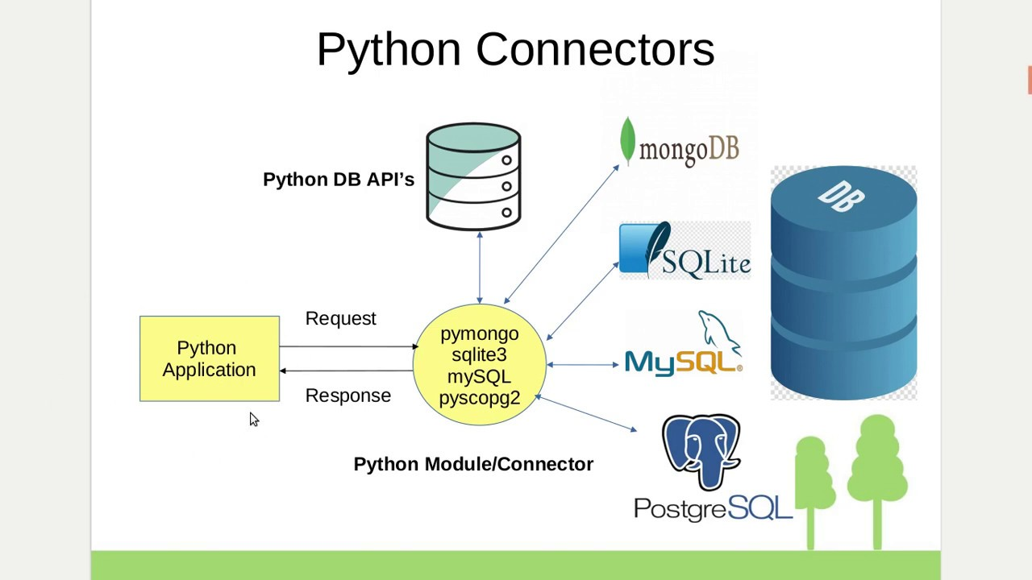

Slide 6
Connect to a MySQL Database in Python
The general workflow of a Python program that interacts with a MySQL-based database is as follows:
Connect to the MySQL server.
Create a new database.
Connect to the newly created or an existing database.
Execute a SQL query and fetch results.
Inform the database if any changes are made to a table.
Close the connection to the MySQL server.

Slide 7
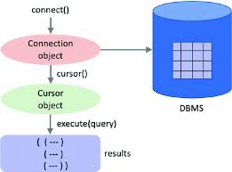
Connect to a MySQL Database in Python

Slide 8
Test MySql Connector
import mysql.connector
Create Connection:
import mysql.connector
mydb = mysql.connector.connect(host="localhost",user="yourusername",
password="yourpassword“)
print(mydb)

Slide 9
Creating a Database To create a database in MySQL, use the "CREATE DATABASE" statement:
import mysql.connector
db = mysql.connector.connect(host="localhost",user=“root",
password=“12345678“)
mycursor = db.cursor() mycursor.execute("CREATE DATABASE mydatabase")

Slide 10
Check if Database Exists
You can check if a database exist by listing all databases in your system by using the "SHOW DATABASES" statement.
import mysql.connector mydb = mysql.connector.connect( host="localhost",user="yourusername", password="yourpassword") mycursor = mydb.cursor() mycursor.execute("SHOW DATABASES") for x in mycursor: print(x)

Slide 11
Creating a Table
To create a table in MySQL, use the "CREATE TABLE" statement.
Make sure you define the name of the database when you create the connection
import mysql.connector
mydb = mysql.connector.connect(host="localhost",user="yourusername",
password="yourpassword",
database="mydatabase")
mycursor = mydb.cursor()
mycursor.execute("CREATE TABLE customers (name VARCHAR(255),address VARCHAR(255))")

Slide 12
Primary Key
When creating a table, you should also create a column with a unique key for each record.
This can be done by defining a PRIMARY KEY.
We use the statement "INT AUTO_INCREMENT PRIMARY KEY" which will insert a unique number for each record. Starting at 1, and increased by one for each record.
mycursor = mydb.cursor()
mycursor.execute("CREATE TABLE customers (id INT AUTO_INCREMENT PRIMARY KEY,
name VARCHAR(255), address VARCHAR(255))")

Slide 13
Insert Into Table
To fill a table in MySQL, use the "INSERT INTO" statement.
mycursor = mydb.cursor() sql = "INSERT INTO customers (name, address) VALUES (%s, %s)" val = ("John", "Highway 21") mycursor.execute(sql, val) mydb.commit() print(mycursor.rowcount, "record inserted.")

Slide 14
Select From a Table
To select from a table in MySQL, use the "SELECT" statement
mycursor = mydb.cursor()
mycursor.execute("SELECT * FROM customers")
myresult = mycursor.fetchall()
for x in myresult:
print(x)
(1, 'John', 'Highway 21')
(2, 'Peter', 'Lowstreet 27')
(3, 'Amy', 'Apple st 652')
(4, 'Hannah', 'Mountain 21')
(5, 'Michael', 'Valley 345')

Slide 15
Wildcard Characters
You can also select the records that starts, includes, or ends with a given letter or phrase.
Use the % to represent wildcard characters
mycursor = mydb.cursor() sql = "SELECT * FROM customers WHERE address LIKE '%way%'" mycursor.execute(sql) myresult = mycursor.fetchall() for x in myresult: print(x)
(1, 'John', 'Highway 21')
(9, 'Susan', 'One way 98')
(14, 'Viola', 'Sideway 1633')

Slide 16
Update Table
You can update existing records in a table by using the "UPDATE" statement.
mycursor = mydb.cursor() sql = "UPDATE customers SET address = ‘Gandhi nagar' WHERE address = 'Valley'" mycursor.execute(sql) mydb.commit()

